Slide 1


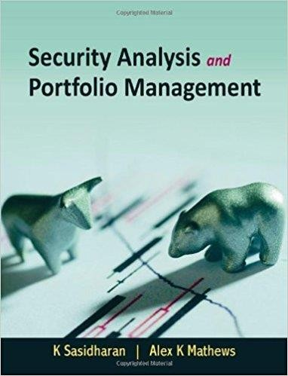
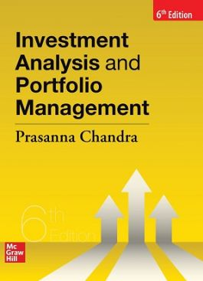


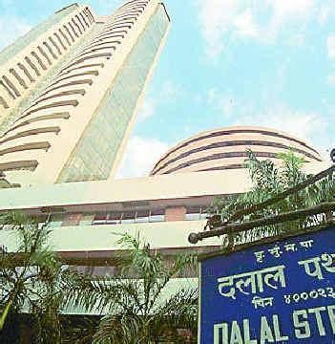
Lecture #0
FINM694

Slide 2


A course: Macro Structure
What?
Course Design
Why
How?
IPs
Design
Delivery
Course
Lecture
#0

Slide 3

Course details
LTP – 3 1 0 [lectures/week]
Course communication mode
Text Book
INVESTMENT ANALYSIS AND PORTFOLIO MANAGEMENT by PRASANNA CHANDRA, MCGRAW HILL
Reference
INVESTMENT ANALYSIS & PORTFOLIO MANAGEMENT MODULE by Y NATIONAL STOCK EXCHANGE,
SECURITY ANALYSIS AND PORTFOLIO MANAGEMNT by SHALINI TALWAR, CENGAGE LEARNING

Slide 4
Course Outcome
CO1 :: evaluate various concepts and principles related to investment analysis and portfolio management
CO2 :: assess the characteristics of different Investment alternatives to trade in the stock market
CO3 :: demonstrate the power of diversification to optimize portfolios returns while minimizing the risk
CO4 :: construct an optimum portfolio minimizing the risk and maximizing the profits
CO5 :: compare and contrast various portfolio management theories
CO6 :: analyze critically the usage of derivative instruments in investment portfolio

Slide 5
Program Outcome Mapping With MGNM580
PO1: Developing responsiveness to contextual social issues and exploring solutions in the light of social and business ethics.
PO2 : Apply research tools for analytical decision making and problem solving using cross functional information.
PO3: Demonstrate global outlook with ability to identify challenges and opportunities in view of Cross-Cultural Understanding
PO4: Leveraging domain knowledge for organizing information, analysis and exploring business opportunities
PO6: Demonstrate proactive leadership and building effective teams to handle challenging assignments.
PO7: Evaluate and execute ideas for entrepreneurship while taking calculated risks.
PO8: Leverage technology for efficient and effective functioning through information sharing and collaboration.

Slide 6
Vision & Mission
Vision
To be a premier academic institution, recognized internationally for its contribution to industry and society through excellence in teaching, learning, research, internationalization, entrepreneurship and leadership.
Mission
To transform education through academic rigour, practical orientation and outcome based teaching.
To develop and implement a relationship of cooperation between industry and academia.
To undertake impactful research addressing local, national and global challenges.
To prepare graduates to be lifelong learners with strong analytical and leadership skills.
To develop global professionals and entrepreneurs with innovative spirit, tolerance and desire to make a difference to the society.

Slide 7

Quiz/Poll
Can Bitcoin be treated as an investment alternative?
YES
NO

Slide 8
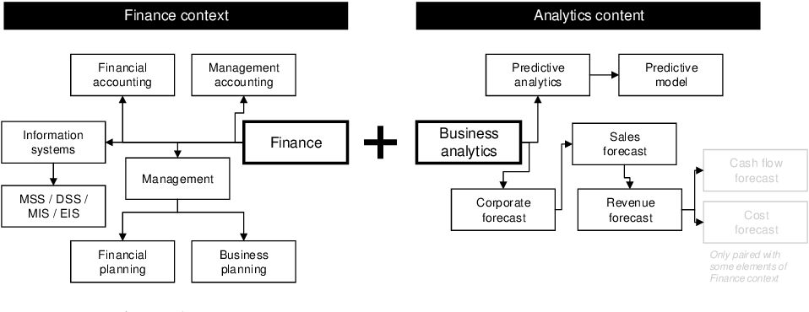


Slide 9
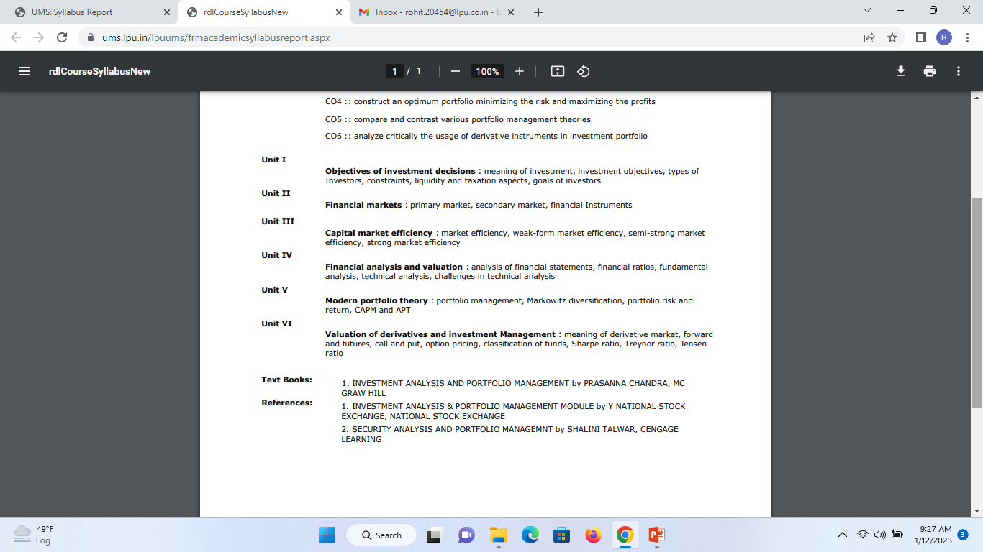
The course contents

Slide 10
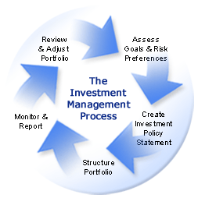
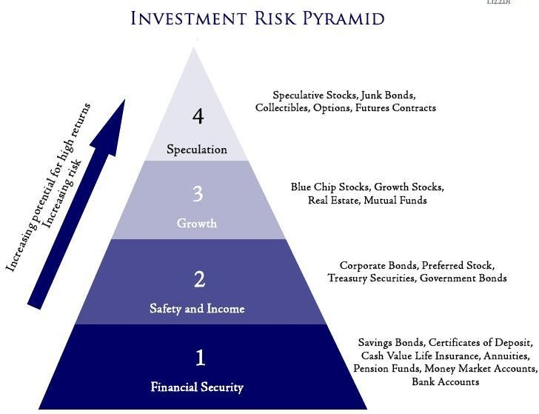
What do we need to know?
Objectives of investment decisions
Unit 1

Slide 11



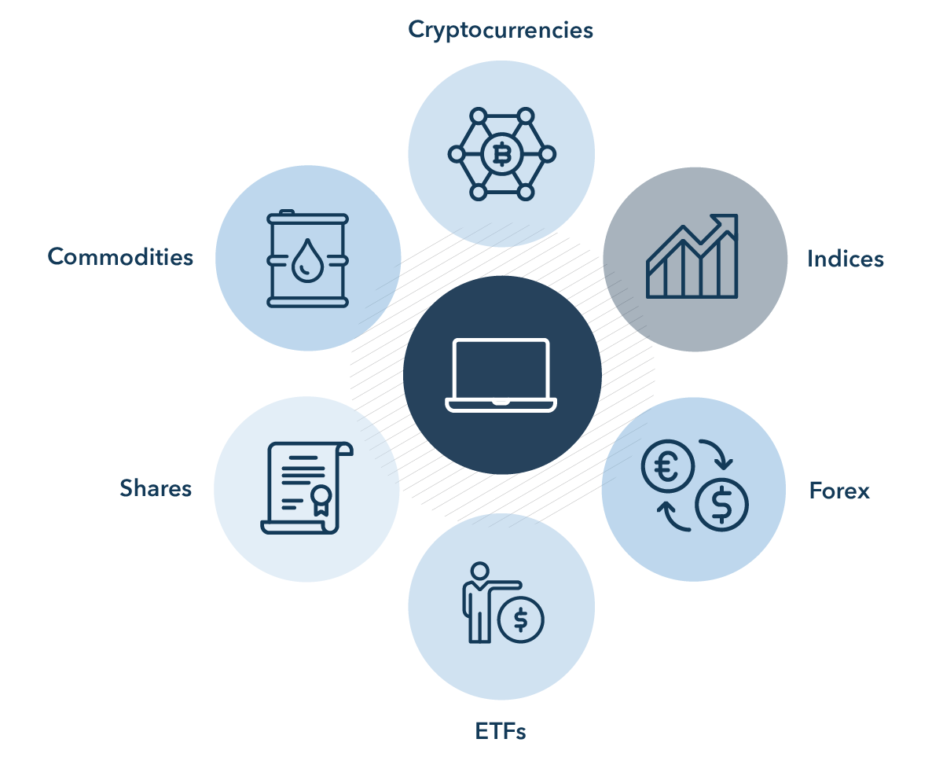
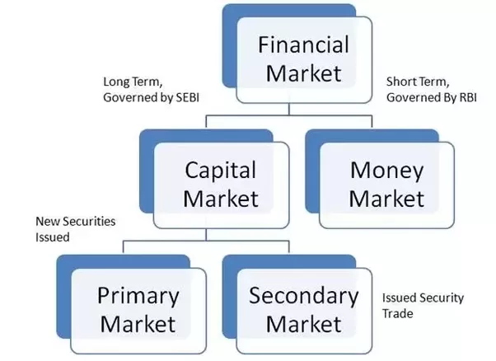
Unit 2

Slide 12
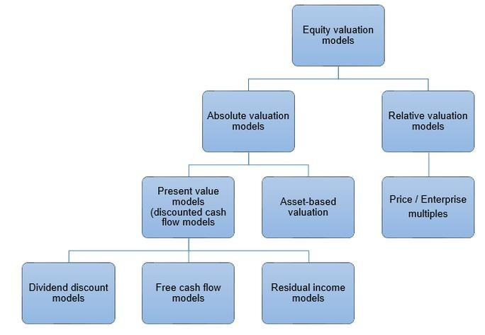


Unit 3

Slide 13
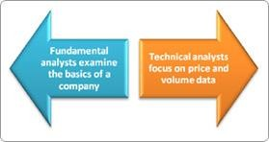
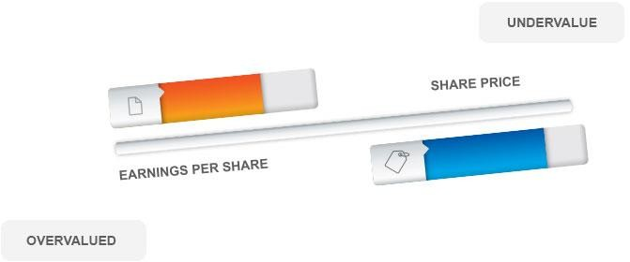
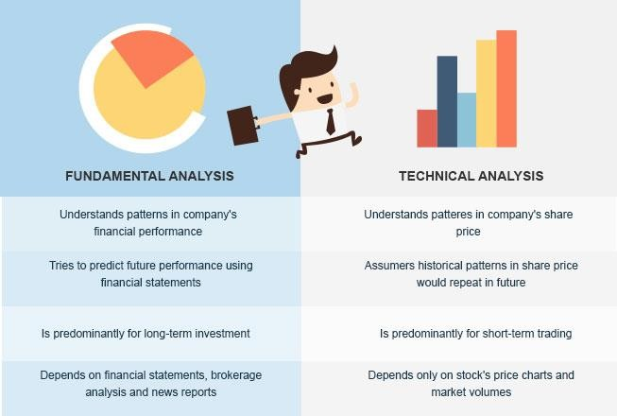
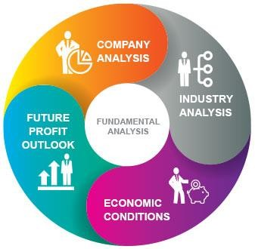
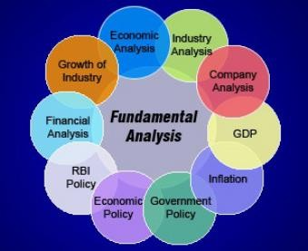
Unit 4
Capital market

Slide 14
Quiz/Poll
The market price of a share of common stock is determined by:
The board of directors of the firm.
The stock exchange on which the stock is listed.
The president of the company.
Individuals buying and selling the stock.

Slide 15
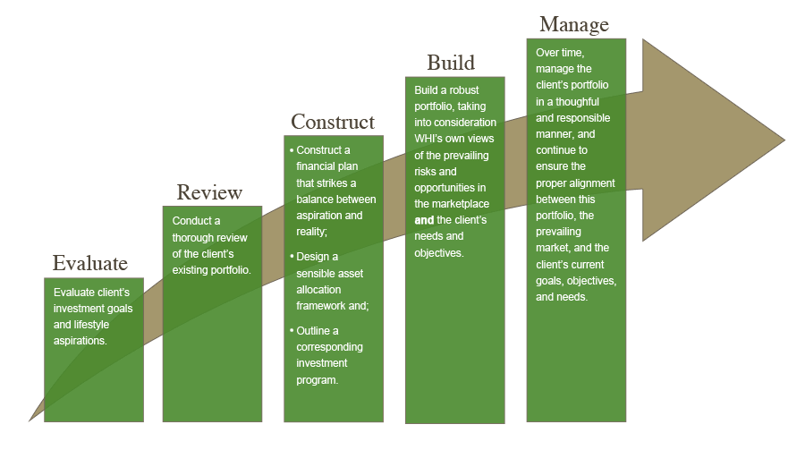
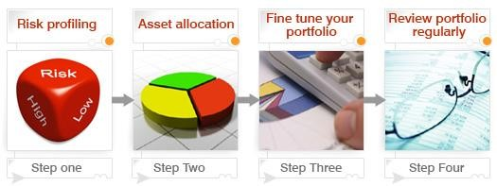
Unit 5
Modern Portfolio Theory

Slide 16
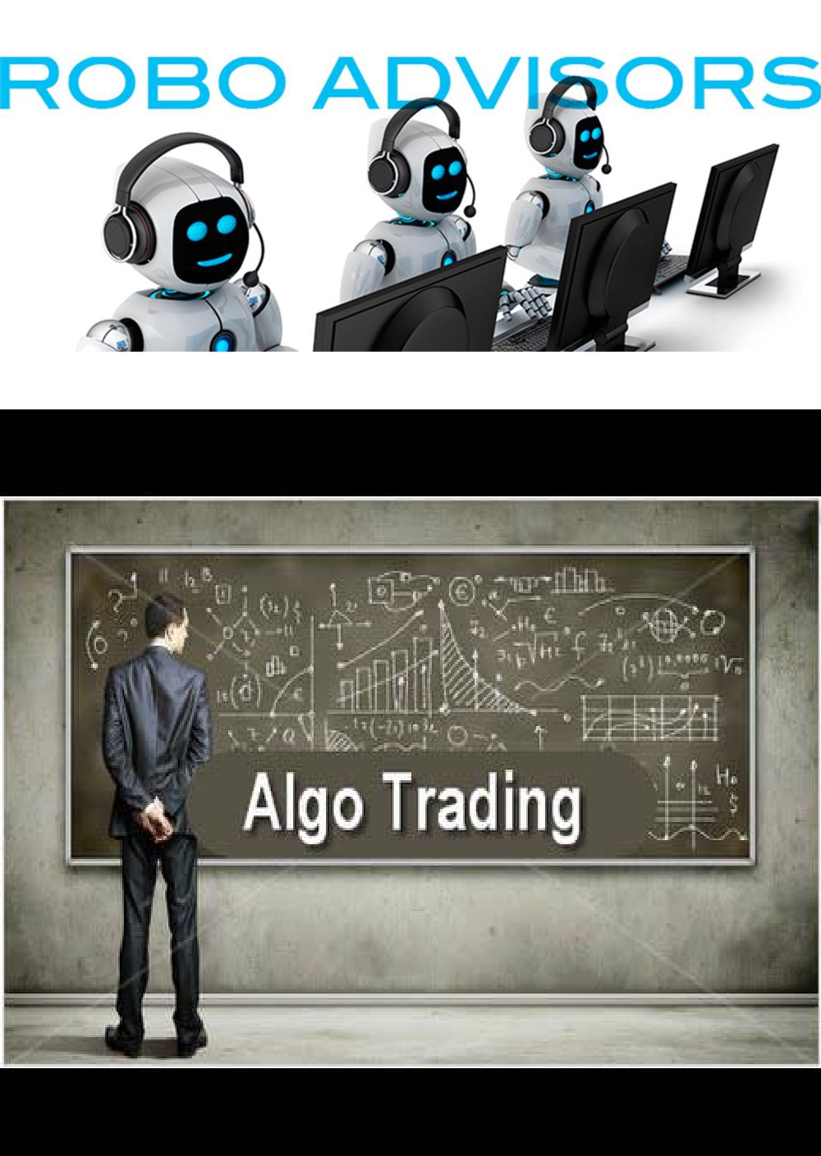
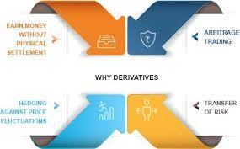
Derivative and Regulatory Aspect
Unit 6

Slide 17
Student’s Role
Enable you to understand the evolution, basic concepts, underlying
principles and terminologies of Securities Market
Need to study about the security analysis through simulation and analyze risk and return of different securities.
Need to apply principles of pricing and valuation for taking sound Investment decision
Need to analyze and optimize portfolios using various models in different market condition.
Go through the conceptual clarity about each topic.

Slide 18

Course Assessment Model
Assignments (Group Tasks)
CA Category of this Course Code is:A0202 (2 out of 2)
Attenance 5
CA 45
ETE 50
Total 100

Slide 19
Assignment 1
Preparation of Dummy Portfolio with fundamental and technical analysis(
Group).
Dummy Portfolio: Rules for dummy portfolio:
1. Every student is supposed to create one portfolio on https://in.finance.yahoo.com
2. Each student will get Rs 20 Lakhs virtual cash for investing in shares.
3. Each student has to include at least 10 companies of their choices in the portfolio.
4. Portfolios can be shuffled / updated (buy & sell changes) only once in a week.
5.Students are required to churn the portfolio at least 5 times during the semester and within the prescribed dates for assignment allotment and submission.
6.Every student has to submit a final report with snap shots (for every churning i.e. snap short of the portfolio before and after churning) of their portfolio results such as net worth (gain or loss) for every week.
Each report carries 6 marks.

Slide 20
Assignment 2
A group of students should select the allotted company for which they must prepare fundamental and technical analysis report in which they have to cover aspects like
Fundamental Analysis of allotted company,
Intrinsic value vs Market value comparison,
Competitive Advantage,
PDC (Pledge, Debt and Corporate governance analysis of last 5 years),
Technical Analysis of allotted company and formation of any two technical indicators through Japanese candlestick charts.
Every group must submit a final report with learnings from the report and practical application of the theoretical concepts in today times. Students must critically analyze and compare with the peers about the strengths and weakness of the allotted company and key points in the fundamental and Technical analysis to understand and apply the learned principles in live market.
Evaluation will be done as per the rubrics depending on the Fundamental Analysis: 10 Marks, Technical Analysis: 10 Marks and practical implications of Intrinsic Value: 10 Marks.

Slide 21
Online Courses and External Certifications
Certification in IAPM
https://in.coursera.org/specializations/investment-portolio-management
https://www.nseindia.com/learn/self-study-ncfm-modules-intermediate-investment-analysis-and-portfolio-management
Financial Modeling Certification by IMS Pro-School
http://www.proschoolonline.com/financial-modeling-course

Slide 22
Resources
Text book: Security Analysis and Portfolio Management by K Sasidharan & Alex K Mathews, Mcgraw Hill Education
Basic Finance: Offered by Course Era
Mooc/Nptel Courses
Security Analysis: Offered by NSE NCFM Courses
Videos on Financial Management on You Tube
Journals: Indian Journal of Finance,
Journal of International Financial Management and Accounting
Excel for various calculations
Annual Reports of company

Slide 23
Career Opportunities
Money and Capital Markets
Financial Planner,
Wealth Manager/Advisor
Stockbroker/Brokerage Houses
Portfolio Manager
Securities Analyst
Investment Advisor

Slide 24

Skill Set
Data Analysis
Quantitative Analysis
Number Crunching
Forensic Audit
Financial Accuracy

Slide 25
Why Investment Analysis and Portfolio Management
Work with financial assets
Online Certifications
Simulation
Value of financial assets
Risk versus return
Asset allocation
Portfolio Management and evaluation

Slide 26
Issues In IAPM
Contemporary issues in finance
Security Analysis Issues of the New Millennium
International financial reporting standards
The effect of changing technology
The globalization of business

Slide 27


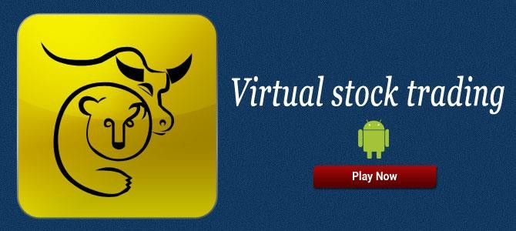



Lecture Delivery

Slide 28
Get Set Go!!!
Gear up
Fasten your seat belts
Explore and manage Risk to Create Wealth…

Slide 29




